Slide 1
Functional Programming Explains
Kimmy Leo @ CUIT <KENPUSEY@OUTLOOK.COM>

Slide 2
A Mathematic Problem
Given a function
f(x) = x^2+ 2*x
Bind/Apply value
let x = 5
Get result
then f(x) = 35

Slide 3
Try others
g(x)=
f(x)=
sin(x)^2
sqrt[log(x)/log(x^2+1)]
3
x!
$$\left\{\begin{aligned}\begin{matrix}f(x) & x ≥0\end{matrix} \\ \begin{matrix}g(f\left(x\right)) & x<0\end{matrix}\end{aligned}\right.$$
{█(■8(𝑓(𝑥)& 𝑥 ≥0)@■8(𝑔(𝑓(𝑥))&𝑥<0))┤

Slide 4
Functions
Evaluable
Pure
Stateless
Evaluable
Always returns a specified value when given legal arguments
Pure
Returns strictly same value when given same legal input
Stateless
Function behavior dose not change.

Slide 5
Functional Programming
Technology?
Pattern?
Style?
Convention?

Slide 6
Functional Programming
Paradigms
Object-oriented
Aspect-oriented
Event-driven
Functional
Message-driven
Computation
Functions
Evaluation

Slide 7
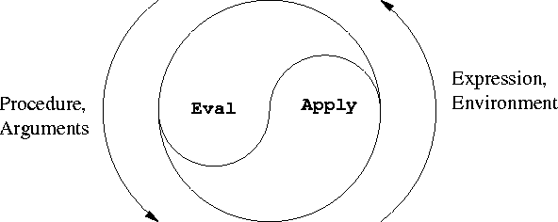
Functional Programming

Slide 8
Principles
Avoiding side-effect
Data-flow based
Bottom-up style
Everything is (immutable)value
Massive recursions & nested/chained calls

Slide 9
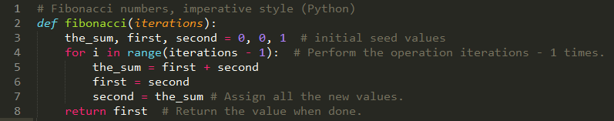
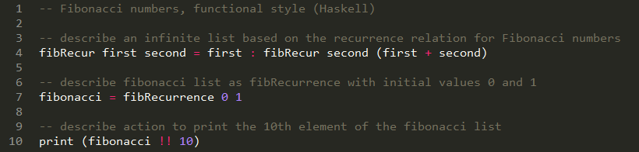
Real World Example (1)

Slide 10
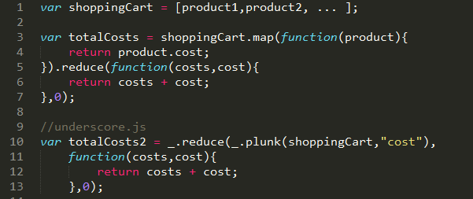

Real World Example (2)
//JavaScript
//Ruby

Slide 11
Strengths
Declarative Style
Clear / Simply
Better List / KV-Map Processing
LISP (LISt Processing) (ancestor of functional programming)
Real World Data Schema
Better for Parallelism
Multicore(process / thread) System
Distributing System
and the trends

Slide 12
MapReduce
Input
Reducer
Output
Mapper
SubTask0
SubTask0-Result
MainTask
SubTask1
SubTask1-Result
Main Result
SubTask2
SubTask2-Result
SubTask3
SubTask3-Result

Slide 13
Practical FP
Programming Language
LISPs ( scheme / Clojure …)
MLs ( Standard ML / Haskell / F# …)
Others ( C++11 / Java 8 / Scala , Python / Ruby …)
Facilities
Anonymous Function ( a.k.a lambda expression )
functor in early C++ & anonymous internal class in java
Closure
Libraries
C++ STL Algorithms / Functor, Guava …
…

Slide 14
e.g.
Map
Enumerable#map(Ruby), map(Python), std::transform(C++)
Iterables.transform(Java/Guava)
foldl(Haskell)…
Reduce
Enumerable#reduce, reduce, std::accumulate …
Filter
std::find_if …

Slide 15
Summary…
Functional Programming is
Just another programming paradigm
A new way to organize & express your thoughts
Non-specific tool
Depends on NOTHING more than your language
even in C / Assembly
Handy, efficient.

Slide 16
Reference
Wiki: Functional Programming
Wiki: Programming Paradigms
Wiki: Lambda Calculus
Elements of Programming: written by father of STL, thinking programs in mathematical way.
SICP: introductive textbook of MIT CS Major, using Scheme to explain the art of programming
The Well-Grounded Java Developer: Practical FP on JVM using Scala / Groovy and Clojure.

Slide 17
Questions?

Slide 18
Thank you!
by @KimmyLeo <kenpusney@outlook.com>

